Slide 1
Challenges for law firms
Peter Scott
PETER SCOTT CONSULTING
www.peterscottconsult.co.uk

Slide 2
Challenges now facing law firms
The economy
Legal Services Act implications
Greater regulation and compliance
PI insurers’ attitudes
Technology
Client needs are changing
A fragmented profession
A need to become more competitive
Greater need for resource

Slide 3
The need to be more competitive
“Competition is a process by which …
services that people are not prepared to
pay for;
high cost methods of production; and
inefficient organisations are weeded out; and
opportunity is given for new…services methods and organisations to be tried” *
Could this apply to the legal profession today?
*Everyman’s Dictionary of Economics

Slide 4
The greatest danger?
- complacency!
“Our strategy is to keep a lid on
expenditure and weather the storm. We
cannot reinvent ourselves as something
we are not”
Managing Partner of a major London law firm – Autumn 2008

Slide 5
An alternative view…
“there seems to be a disturbing strategy of hunkering
down, cutting some fat and hoping that business will
return to normal. That is not good. The terrain will look
very different when this is over. This is not a minor blip,
but a discontinuity”
“the problem is that most senior lawyers think only two months ahead.
They have no coherent picture of the future. The planning is not being
done. And it is senior lawyers who need to be driving change”
Professor Richard Susskind – May 2009

Slide 6
Where are you now?
What are the most important lessons you
have learnt from the recession?

Slide 7
A chance to make a new start
Which of those lessons will you use to
build success for the future?
Name one change which would make a greater difference to your firm than any other

Slide 8
Forward planning - focus on the fundamentals
Your clients
Your people
The kind of firm you want to be
How you can achieve your goals

Slide 9
This will require leadership
Thinking and visionary
Challenging
Inspirational
A determination to implement change

Slide 10
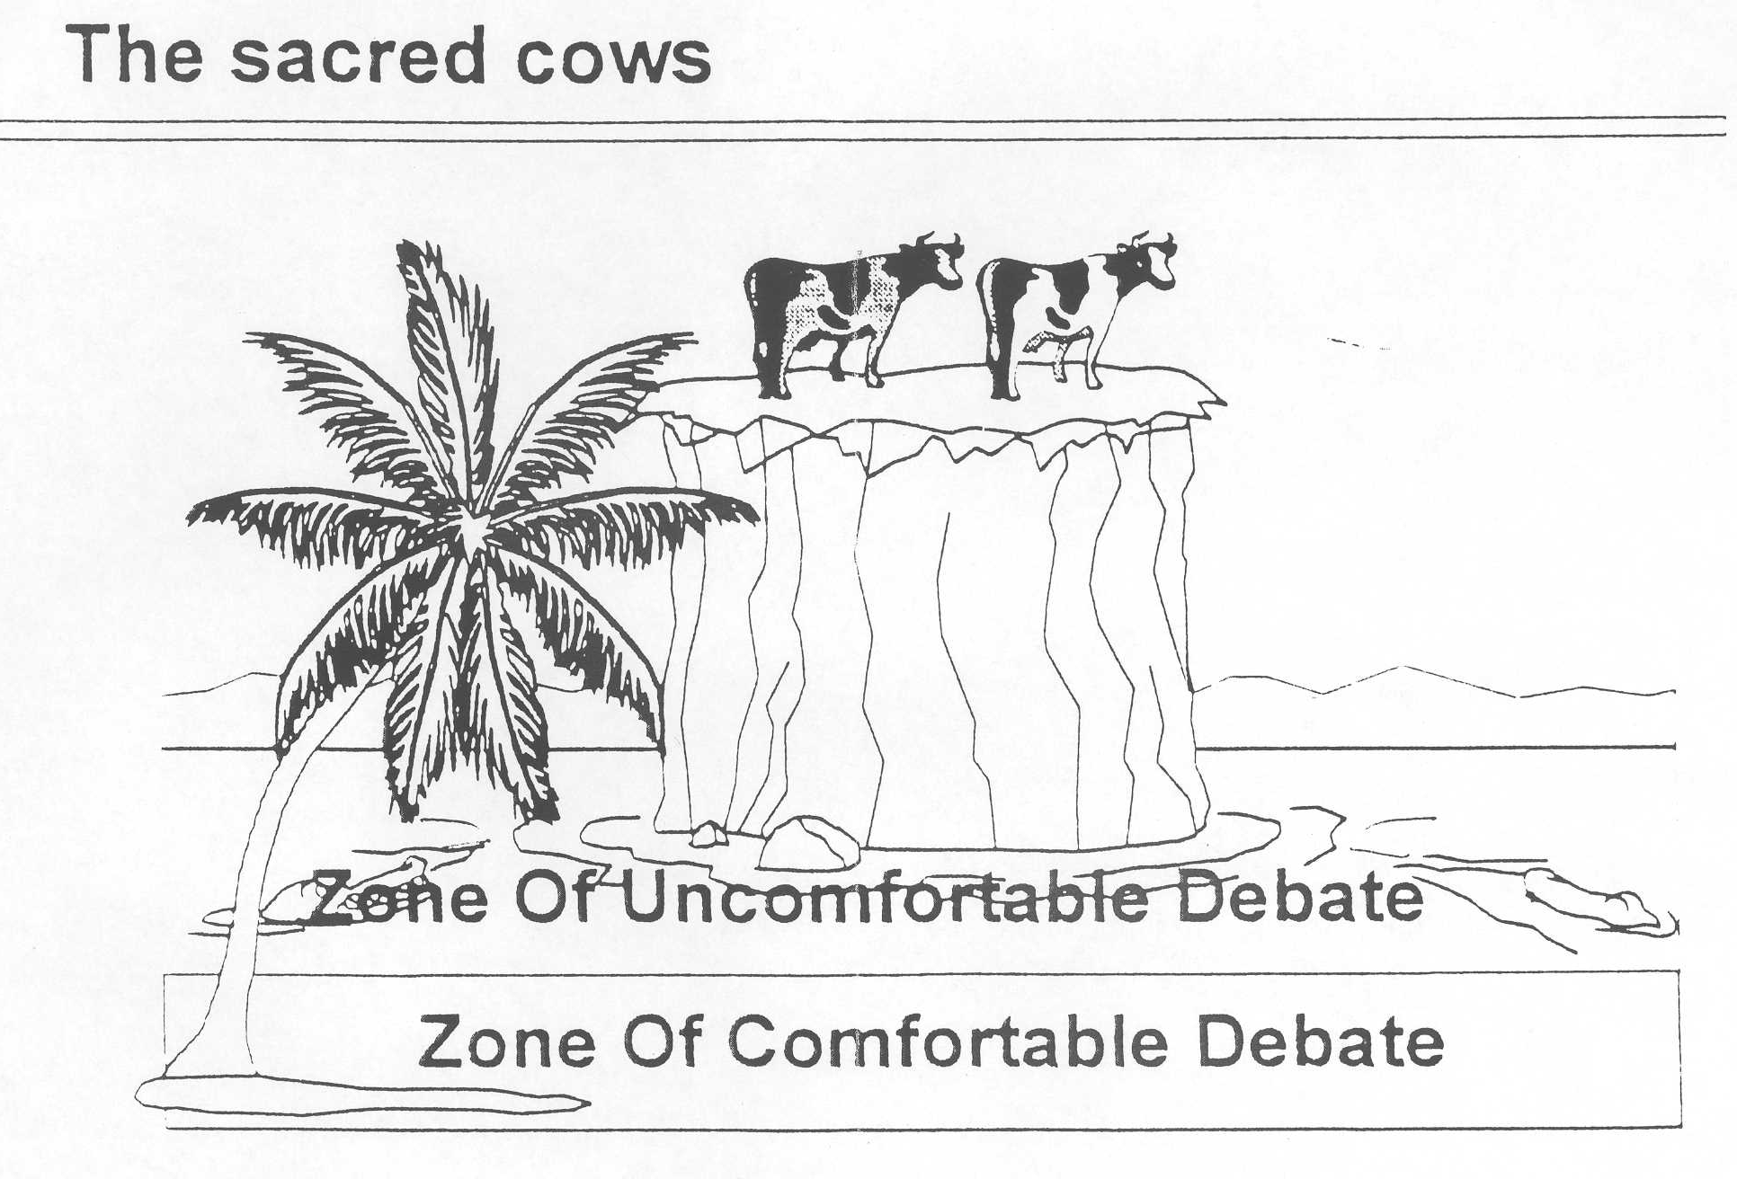
Forward planning - there may never be a better time to face up to your sacred cows

Slide 11
Developing a strategic vision in a partnership …
is a process of finding out:
What your (current and prospective) clients value
What your partners value
Identify key skills and behaviours which enable the consistent delivery of your value proposition

Slide 12
Smaller firms need strategic focus
They cannot be ‘all things to all men’
To be competitive requires focus on a client-type / work type mix
Sharper focus on client/work types than larger firms
wider focus than niche firms

Slide 13
Finding out what your clients value…
will identify the key skills and behaviours which will enable the consistent delivery of your value proposition
But – are your partners prepared to adopt the values and behaviours necessary to enable the firm to do so?

Slide 14
Your values?
What is valued in your firm?
Do you reward what you value?
Do you invest in what you value?
What does it take to succeed at
your firm?

Slide 15
How many of you do not have any partners who…
Are underperforming?
Have attitude / behavioural problems?

Slide 16
Are internal attitudes in your firm holding you back?
Are you presently unable to add
value to your clients because of
internal attitudes and behaviour?

Slide 17
How to achieve your goals

Slide 18
In a fast changing world law firms need to constantly adapt
The economy
Legal Services Act implications
Greater regulation and compliance
PI insurers’ attitudes
Technology
Client needs are changing
A fragmented profession
A need to become more competitive
Greater need for resource

Slide 19
You have developed a realistic plan, but…
will you have the resources to achieve your
goals?

Slide 20
Resources which individual firms cannot
realistically and at an economic and
acceptable cost provide themselves

Slide 21
The need for resource
Often a lack of resource of expertise
(client perception surveys will show if this is the
case)
Often a lack of financial resource
(inability to invest in your people and in the
business)

Slide 22
Breadth and depth of expertise
Actual – to provide clients with the added value they
require
Perceived – by clients compared to competitors

Slide 23
Lack of resource may make a firm uncompetitive
‘I don’t believe they have the resources’
‘Sometimes they lack polish and quality in depth’
‘Depth of expertise – I have only one partner to contact on a day to day basis, which is a little limiting…’
(some comments by clients)

Slide 24
Is a lack of internal skills holding you back?
Do your people all have the skills
necessary to enable your firm to achieve
its vision?

Slide 25
Are you investing sufficient in your people to realise their financial value to your business?

Slide 26
Financial resource
Access to greater financial resource can help to:
Provide for quality leadership and management
Provide for necessary infrastructure to underpin provision of high quality legal services:
- KM
- compliance and risk management
- HR (a people business!)
- Technology
Build market share and profile to attract
- better quality people
- better clients

Slide 27
Greater expertise and finance
can help to provide greater reach / access to new and
larger markets:
Geographic
Sectors
More ‘quality’ client types
More premium work types

Slide 28
Is consolidation the answer?

Slide 29
How consolidation between firms in a fragmented profession can help build competitive advantage

Slide 30
You will add value that clients care about if…
You provide clients with what they need
At prices they perceive to be value for money; and
You do this better than the competition
‘They always try to sell to us on price – but what we are really
looking for is a good job to be done at a reasonable price’

Slide 31
How can consolidation help to provide necessary resource?
NB – consolidation is not a panacea
- often just a better platform on which to build a more
competitive law firm
- not about size for the sake of size

Slide 32
Consolidate for the right reasons
consolidation is not a strategy – it is a means to an end – to gain competitive advantage
consolidation can help build RESOURCE – to enable a firm to provide its clients with what they want
Firms need to ask themselves:
“Will we be able to achieve our objectives on our
own”
If not, then consolidation may need to be considered

Slide 33
The scale of a new firm may help to enable…
the new firm to be developed at an
acceptable economic cost to each
constituent firm
- which the individual firms could not on their own provide

Slide 34
Quality Resource to enable the new firm to…
Attract and retain the best
talent

Slide 35
Quality Resource to enable the new firm to…
Provide clients with the depth
and breadth of expertise they
now require, where and when
they need it

Slide 36
Quality Resource to enable the new firm to…
Build the quality management
which will be required to
successfully compete in the
future

Slide 37
Quality Resource to enable the new firm to…
Provide the necessary
infrastructure to underpin the
effective provision of high
quality professional services
demanded by clients

Slide 38
A Vision
To build a law firm which can begin to
compete with larger, more developed
firms for better quality, higher value
work leading to greater
competitiveness and profitability

Slide 39
Is that a Vision you share?

Slide 40
Any questions?

